Slide 1
REAL-TIME
VIOLENCE ALERT SYSTEM
Presented By
Harshita Chawdhary
Jaya Agarwal
Ritika Baluni
Rupsa Ojha
Guide : Dr. Surbhi Saraswat

Slide 2
Problem Statement
⬡ CCTV Surveillance is used to a greater extent but still it lacks the feature
of automatic violence detection
⬡ Manual monitoring is not a feasible task and the time taken to respond to the situation is also crucial
⬡ A Real-Time violence alert is proposed

Slide 3
Methodology
A dataset having 1000 videos each of violence category and non-
violence category was chosen
A model was trained using MobileNetV2 using the dataset
Real-time video footage is given as input
Output is obtained as image frames

Slide 4
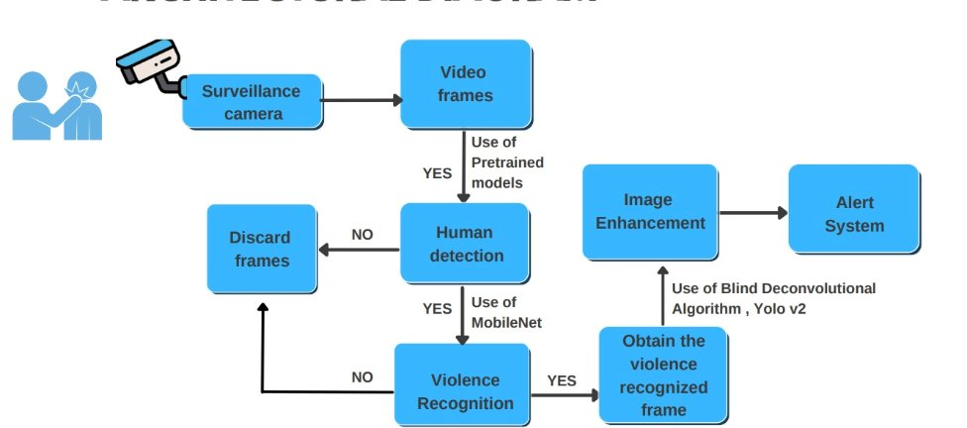
Methodology

Slide 5
MobileNet V2
Algorithm
Convolutional neural network that is 53 layers deep
Provides real-time classification capabilities under computing constraints in devices like smartphones.
Utilizes an inverted residual structure where the input and output of the residual blocks are thin bottleneck layers.
Uses lightweight convolutions to filter features in the expansion layer.

Slide 6
Image Enhancement
Algorithm
⬡ Sharpness and color of obtained output frames is slightly improved
⬡ Uses inbuilt functions – Python PIL Library
⬡ Helps authorities in face detection & cross-checking

Slide 7
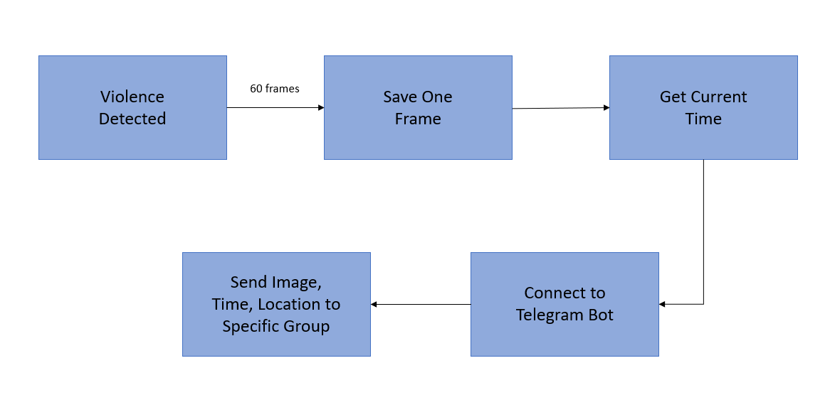
Alert Module

Slide 8
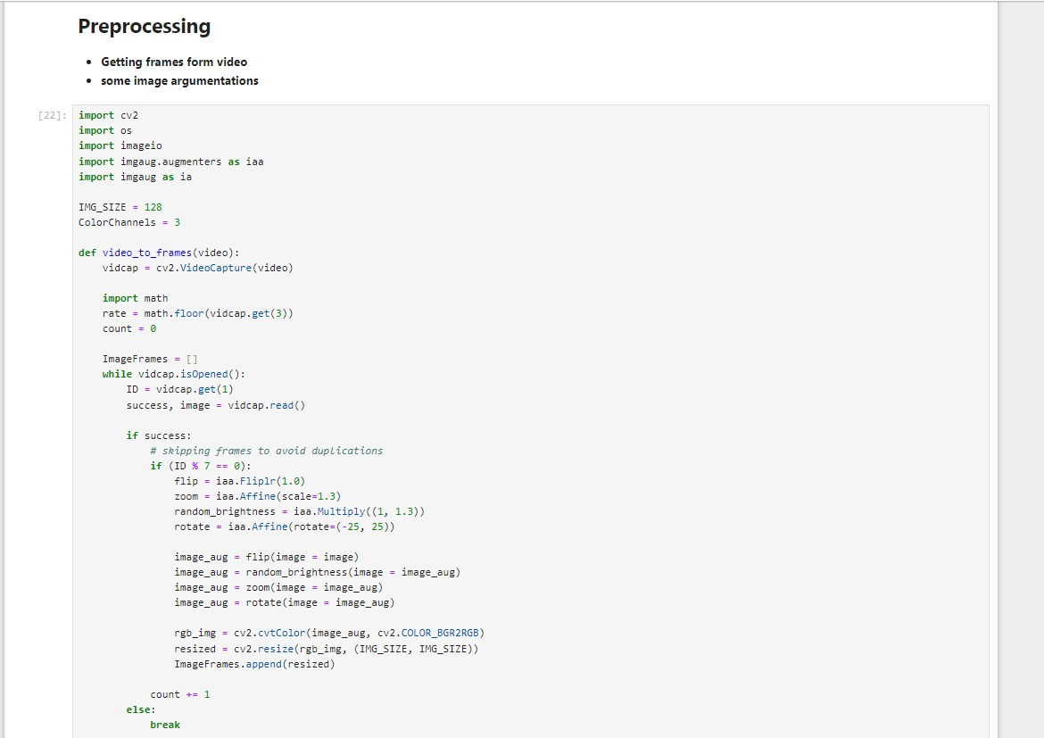
Pre processing

Slide 9
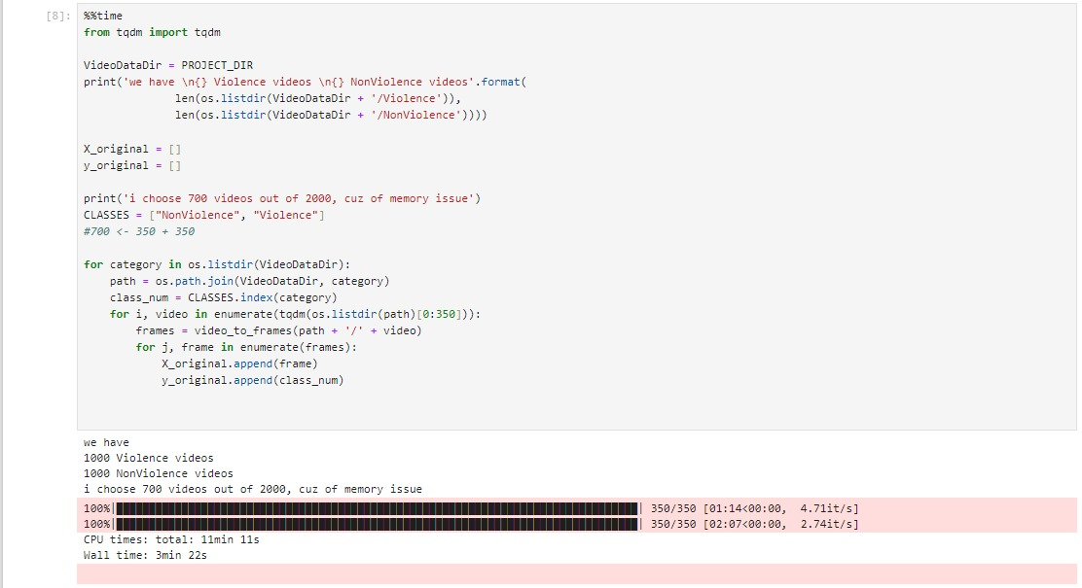
Pre processing
Getting frames from videos and image augmentation

Slide 10
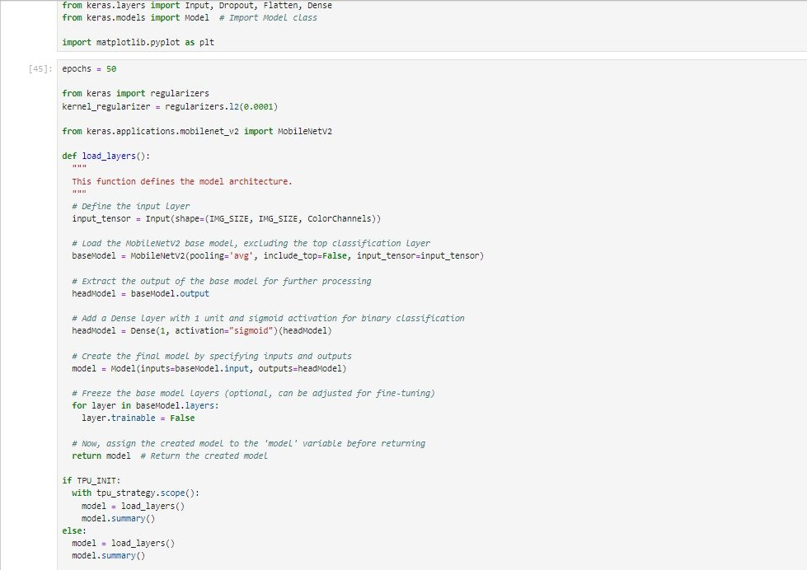
Model training

Slide 11
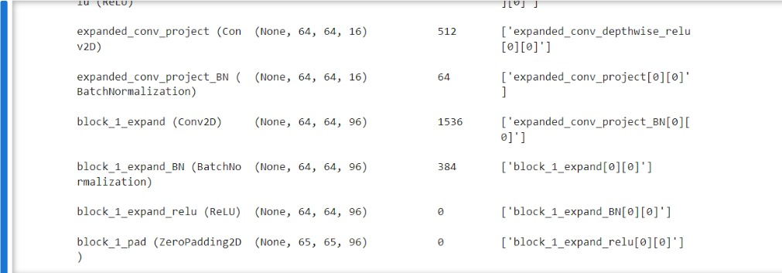
Model training

Slide 12
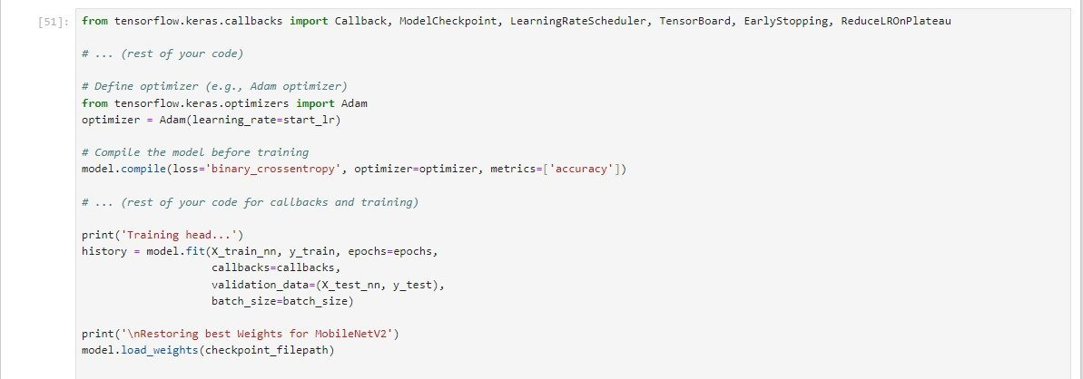
Model Training
loads the weight of the model from file path

Slide 13

Alert System

Slide 14
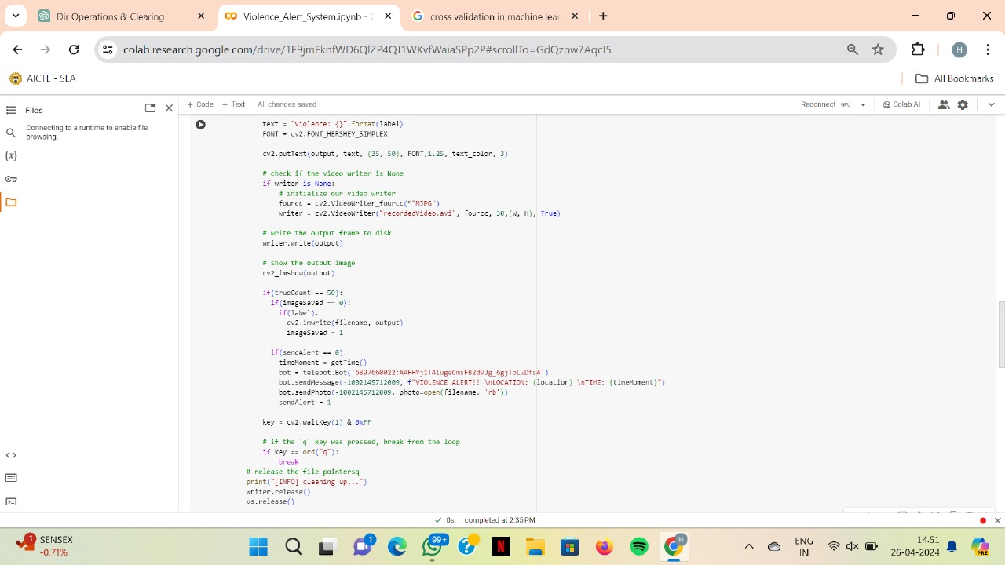
Alert System

Slide 15

Non-violence system

Slide 16
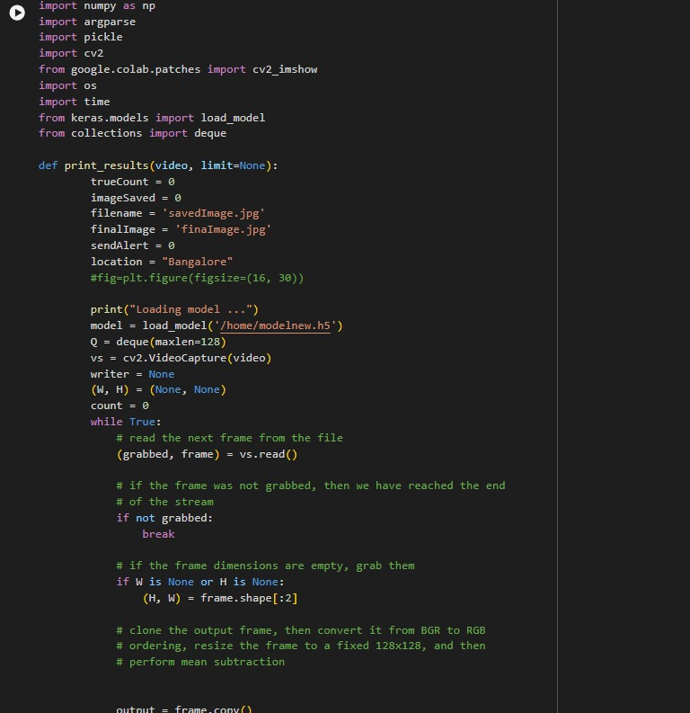
Violence alert system

Slide 17
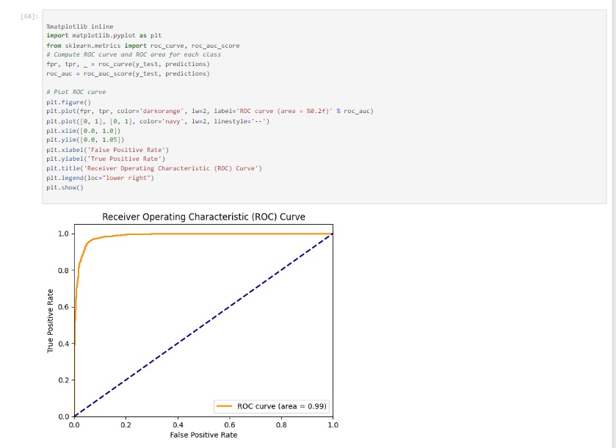
Results
shows the trend of (possibly) accuracy or loss over training epochs.

Slide 18
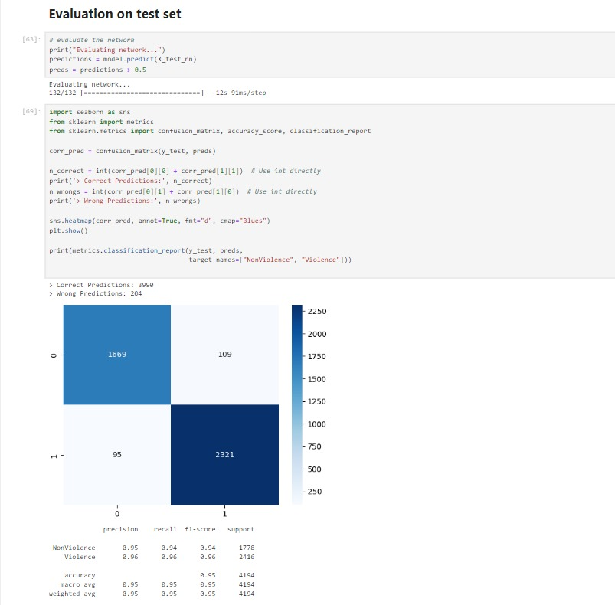
Results
High Classification Accuracy

Slide 19
Results
High Classification Accuracy

Slide 20
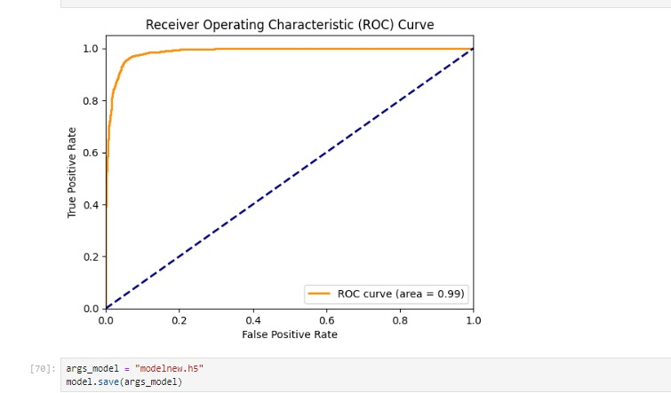
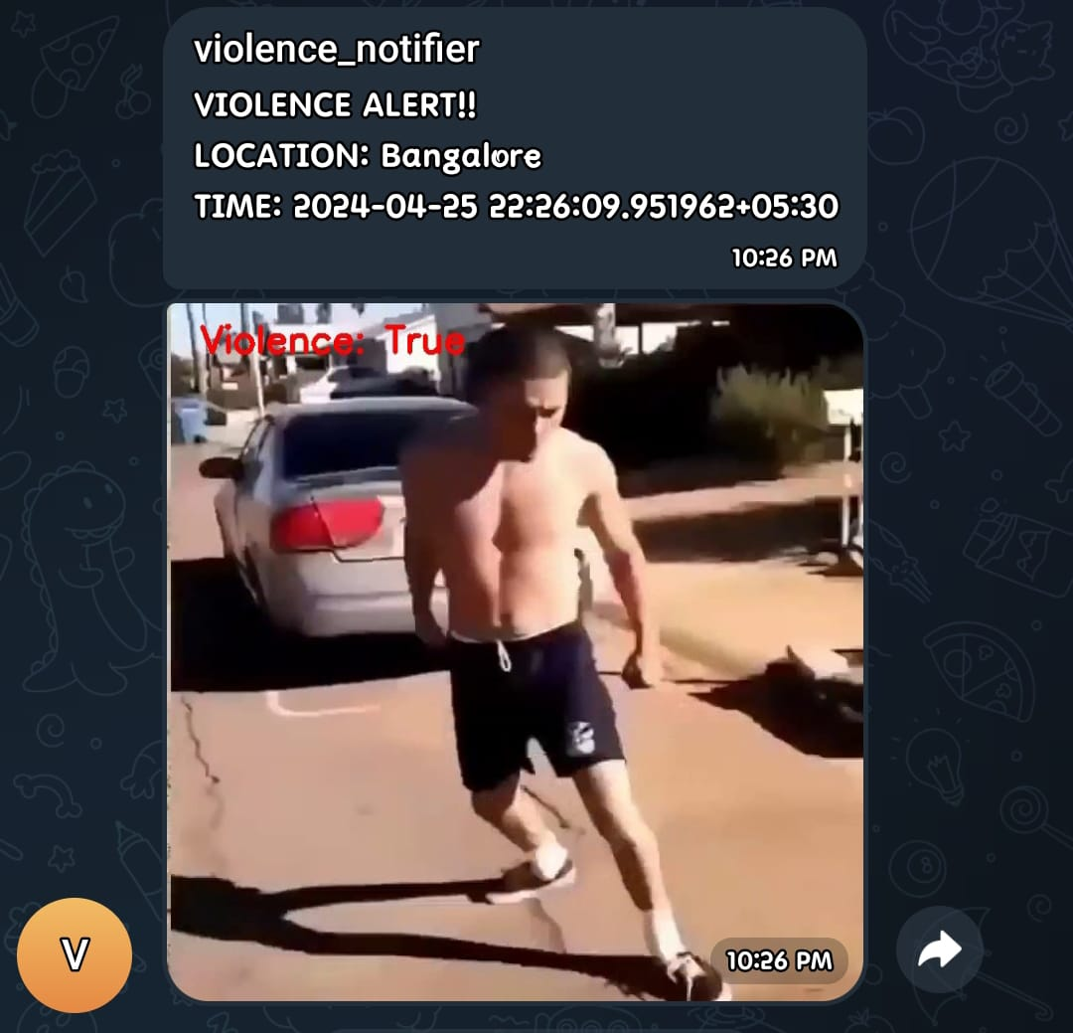
Results
Receiver Operating Characteristic (ROC) Curve

Slide 21

Sample Inputs

Slide 22
References
1] Ahmed, N., Nait-ali, A., & Omar, M. (2016). Real-time human detection and tracking for video surveillance. 2016 13th IEEE International Conference on Advanced Video and Signal Based Surveillance (AVSS), 98-103. doi: 10.1109/avss.2016.7738023
[2] Cong, Y., Yuan, J., Liu, J., & Thalmann, D. (2016). Real-time abnormal event detection in crowded scenes. ACM Transactions on Multimedia Computing, Communications, and Applications, 12(4), 1-21. doi: 10.1145/2973641
[3] Liu, H., Huang, Y., Liu, F., & Zeng, G. (2019). A machine learning based framework for pedestrian detection in surveillance videos. IEEE Access, 7, 34845-34856. doi: 10.1109/access.2019.2901573
[4] Liu, W., Anguelov, D., Erhan, D., Szegedy, C., Reed, S., Fu, C., & Berg, A. C. (2018). Deep learning-based object detection in video surveillance: a review. Journal of Visual Communication and Image Representation, 55, 273-280. doi: 10.1016/j.jvcir.2018.09.009 Saikia, R., Ahmed, S. I., & Das, D. (2019).
[5] Real-time multi-camera vehicle tracking using deep learning. 2019 10th International Conference on Computing, Communication and Networking Technologies (ICCCNT), 1-6. doi: 10.1109/icccnt45670.2019.8945149 Communication and Image Representation, 55, 273-280. doi: 10.1016/j.jvcir.2018.09.009
[6]https://towardsdatascience.com/review-mobilenetv2-light-weight-model-image-classification8febb490e61c

Slide 23



Thank You

